Slide 1
sakiLA EDA QUESTION

Slide 2
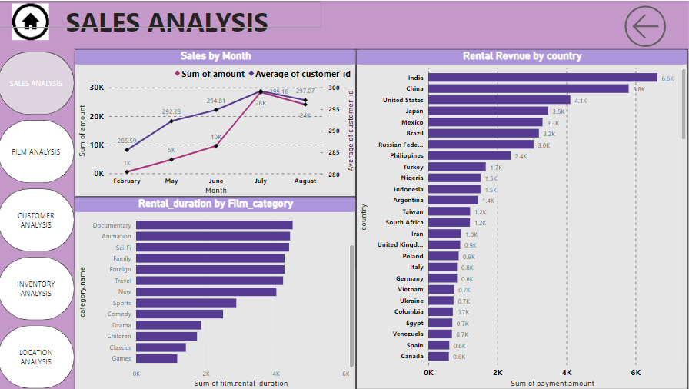

Slide 3
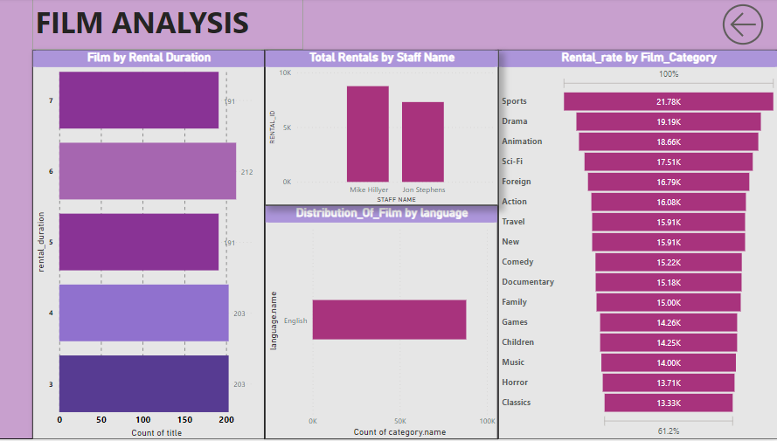

Slide 4
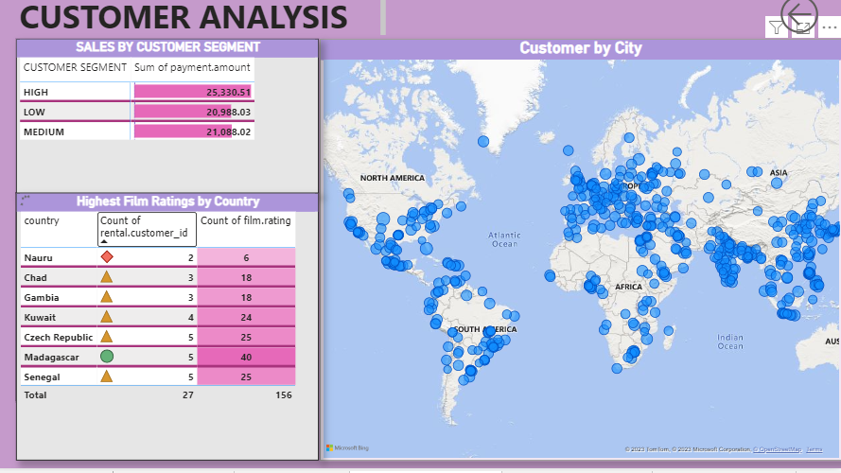

Slide 5
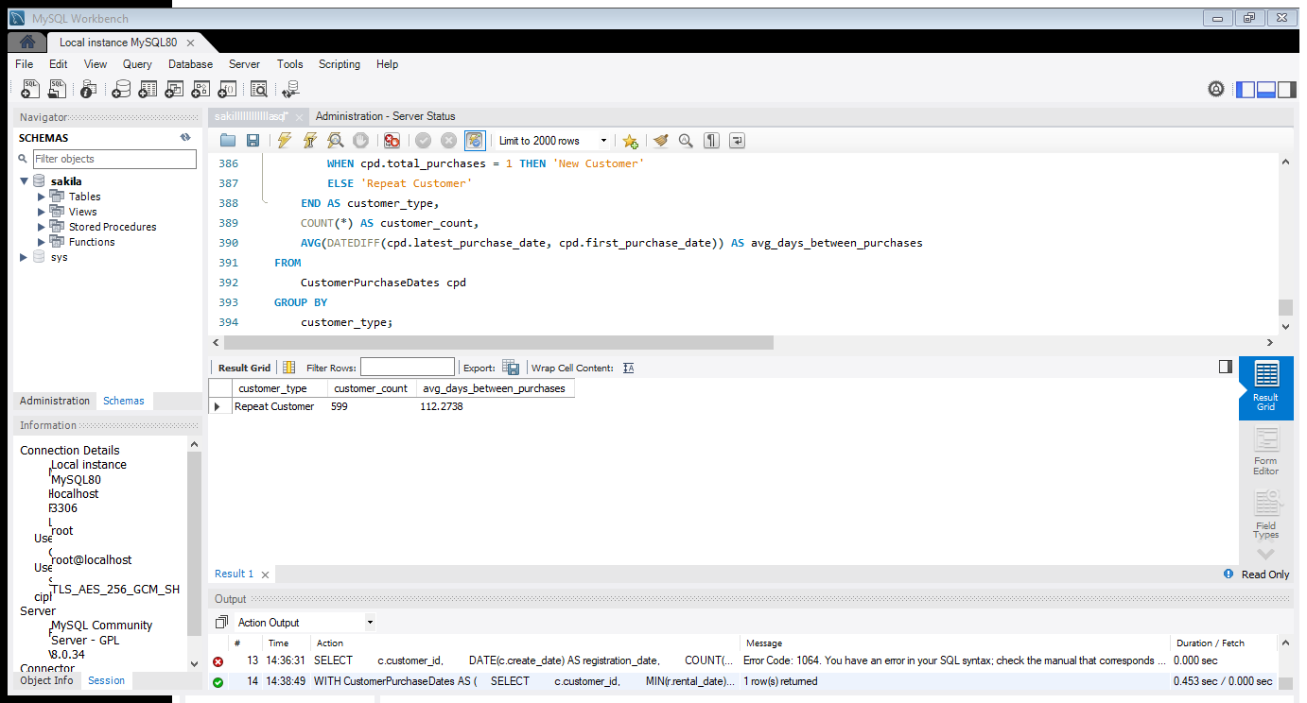
1.What are the purchasing patterns of new customers versus repeat customers?
I Calculates the count of customers in each category and the average number of days between their first and latest purchases

Slide 6
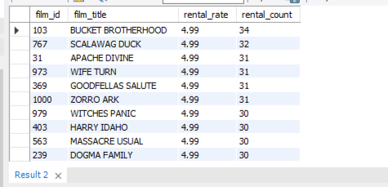
2. Which films have the highest rental rates and are most in demand?
Calculating the rental count for each film by joining the film, inventory,
and rental tables, grouping the results by film ID, title, and rental rate.

Slide 7
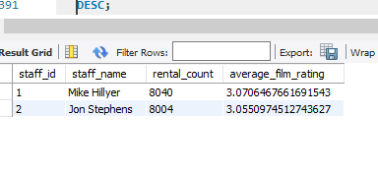
3. Are there correlations between staff performance and customer satisfaction?
Retrieves staff-related data, including staff ID,
staff name (concatenated from first and last names), rental count, and
the average film rating of films rented by customers assisted by each staff member

Slide 8
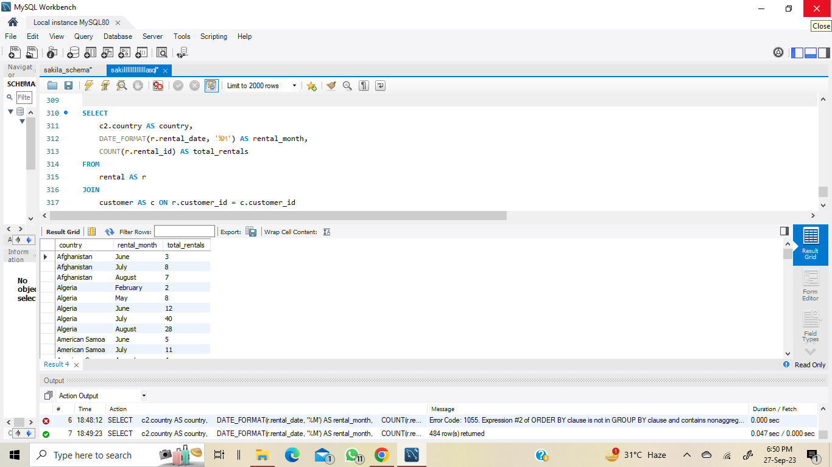
4. Are there seasonal trends in customer behavior across different locations?
I extract the month from the rental_date,
and groups the results by country and month, ordering them first by country and then
by the numeric representation of the month.

Slide 9
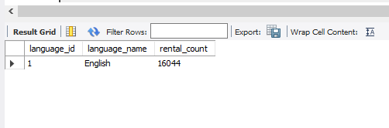
5. Are certain language films more popular among specific customer segments?
This analysis helps identify which film languages are more popular
among customers, as indicated by the rental counts.

Slide 10
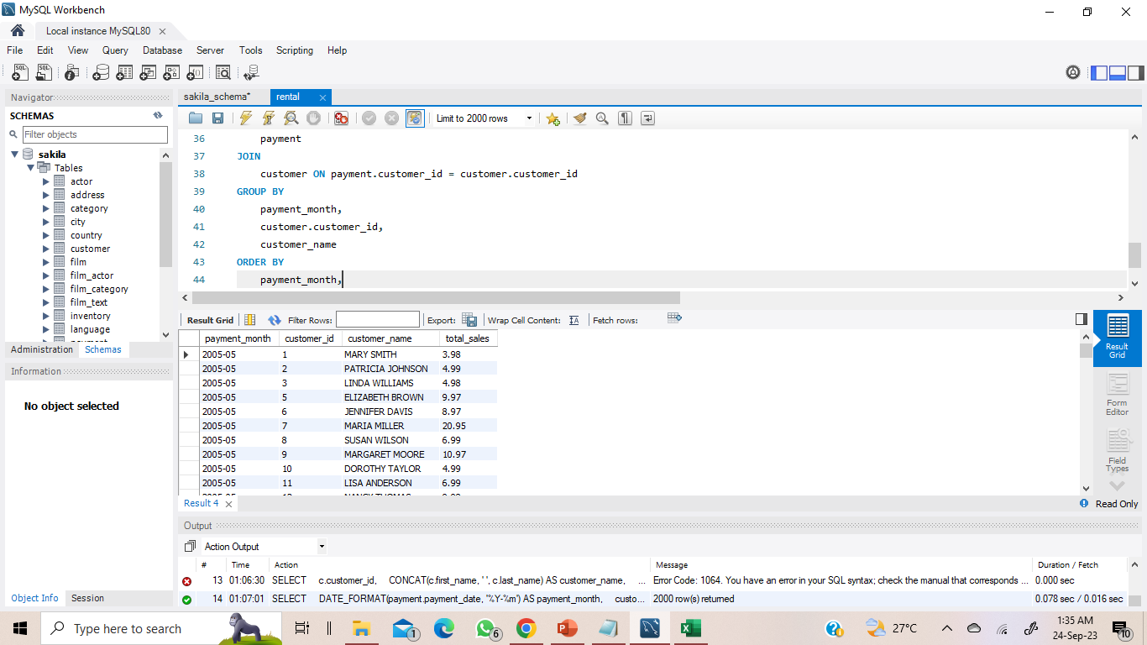
6. How does customer loyalty impact sales revenue over time?
Extracting payment data, including the payment date,
customer ID, customer name, and total sales amount.

Slide 11
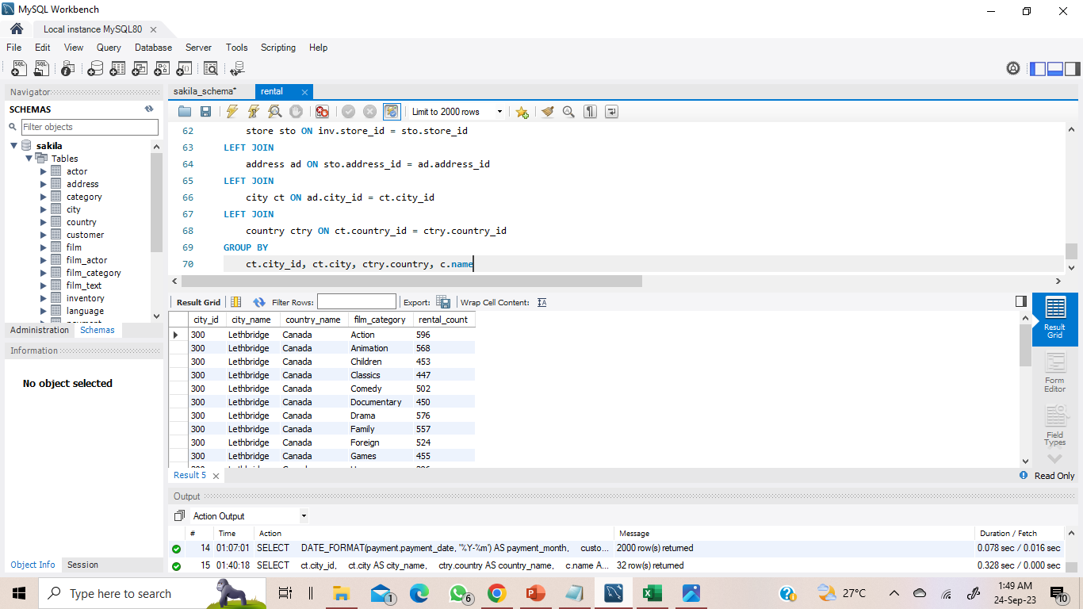
7. Are certain film categories more popular in specific locations?
Information is about rental counts for each film category in different cities and countries.

Slide 12
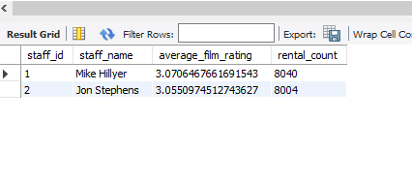
8.How does the availability and knowledge of staff affect customer ratings?
In Bar chart, Calculating the rental statistics for staff members in a film rental store. There is no data related to customer rating, so I did it on the basis of average film rating and store id by staff name

Slide 13
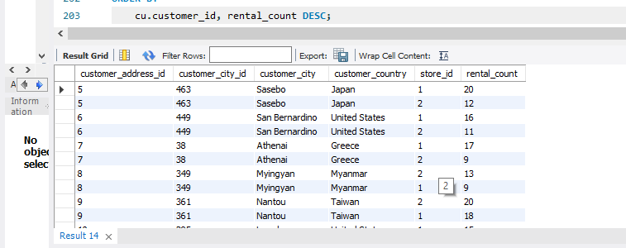
9.How does the proximity of stores to customers impact rental frequency?
Bar chart retrieves customer and rental information for a film rental store. This helps in analyzing customer rental behavior and the performance of different stores in terms of rental counts.

Slide 14
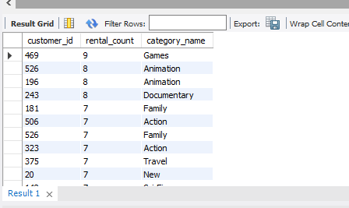
10. Do specific film categories attract different age groups of customers?
Analysing customer rental behavior by counting the number of rentals (rental_count) for each customer across different film categories.
There is no data related to age, so I sum rentals and count of customer_id on the basis of film category

Slide 15
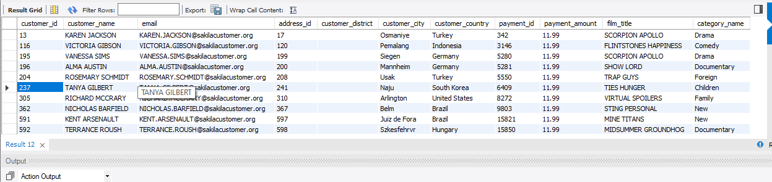
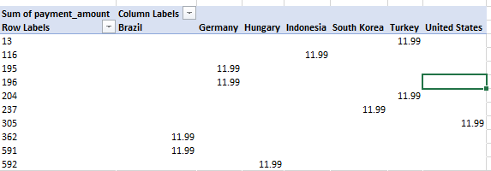
11.What are the demographics and preferences of the highest-spending customers?
Gather information about customers who made the highest payment (payment_amount) in a single rental transaction.

Slide 16
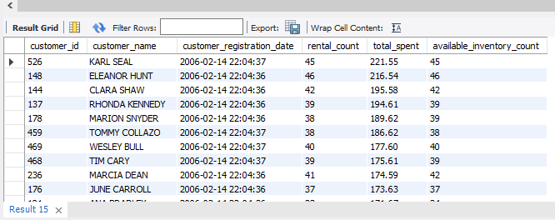
12. How does the availability of inventory impact customer satisfaction and repeat business?
This line chart shows customer-related information, including customer ID,
customer name, registration date, rental count, total amount spent, and
available inventory count.

Slide 17
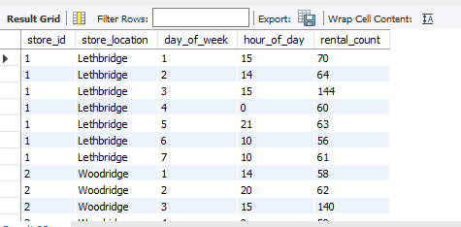
13. What are the busiest hours or days for each store location, and how does it impact staffing requirements?
Chart shows store-related information, including store ID, store location, day of the week, hour of the day, and rental count. It filters the results to only include rows where the rental count matches the maximum
rental count for each store and day of the week combination
store_idfg | store_location | day_of_week | hour_of_day | rental_count
1 | Lethbridge | 4 | 21 | 63
2 | Woodridge | 1 | 20 | 62

Slide 18
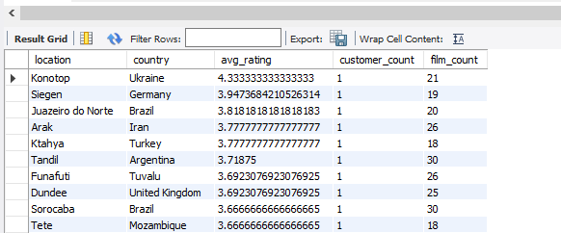
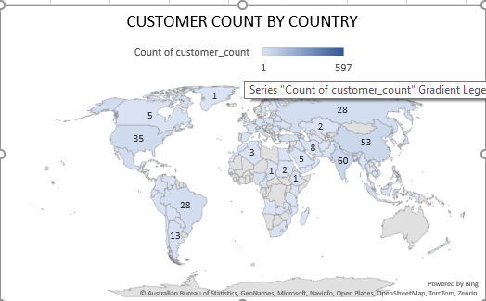
14. What are the cultural or demographic factors that influence customer preferences in different locations?
Map shows information about different store locations,
including the city and country, and calculates the average film rating,
the count of distinct customers, and the count of distinct films
rented for each location

Slide 19
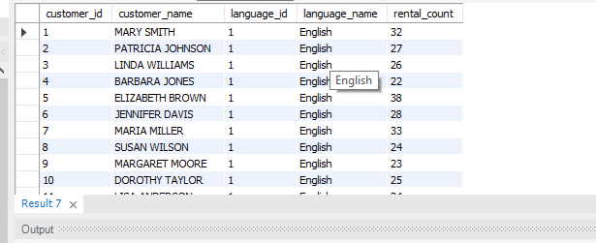
15. How does the availability of films in different languages impact customer satisfaction and rental frequency?
Line chart shows data about customer preferences for films in various languages. It counts how many films each customer has rented in different
languages. But there is only ENGLISH language film avilable

Slide 20
SAKILA POWER BI

Slide 21
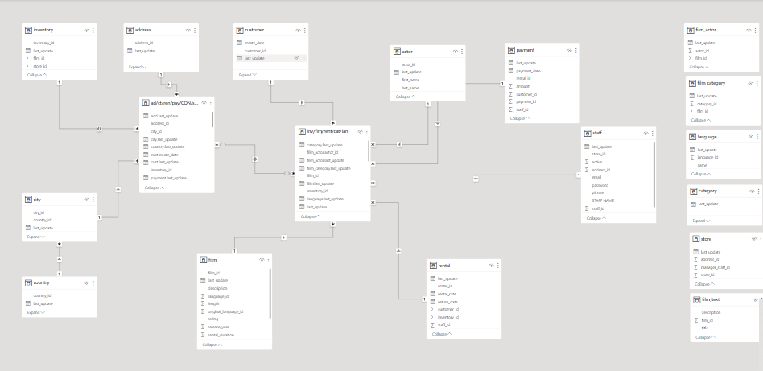

Slide 22
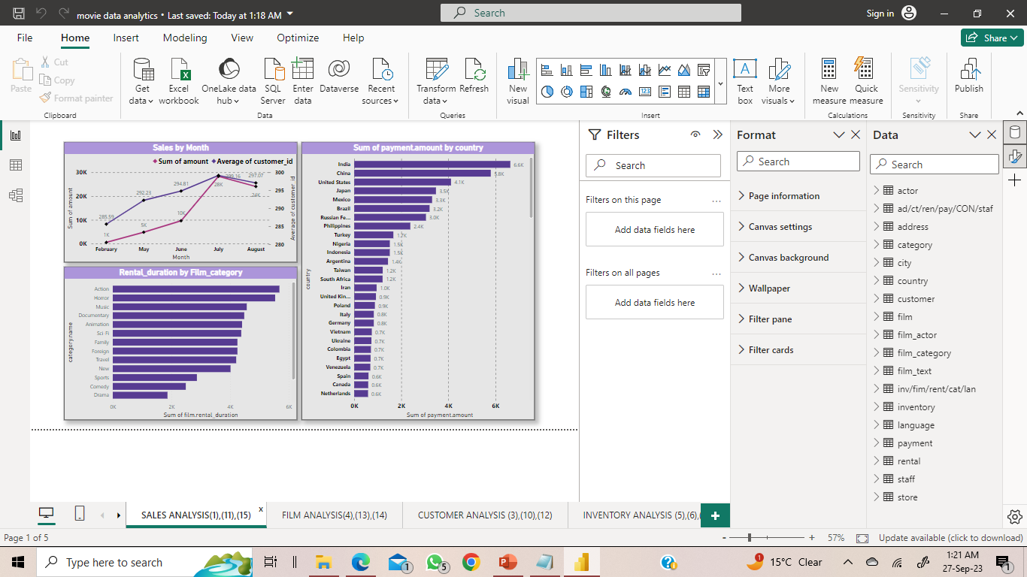
1. How does the sales revenue vary by month?
LINE CHART shows average customers = 28,368.91 and total payment = 299.16 is high in the JULY month.

Slide 23
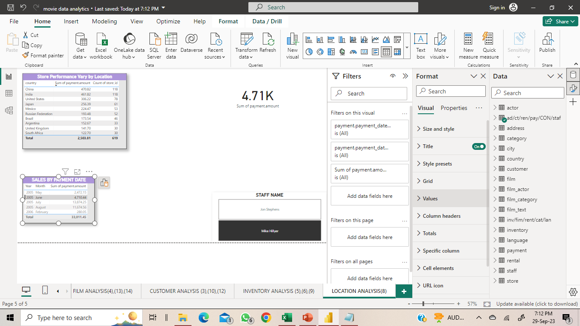
2. What is the distribution of sales by payment method?
Sales by payment method is not possible, payment method not given. So distribution of sales done the basis of year and month. TABLE shows JULY,2005 have highest sales = 13,874.25

Slide 24
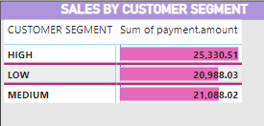
3. Which customer segments generate the highest sales?
IN TABLE, HIGH Customer Segment = 25,330.51 shows Highest sale. Customer Segment have to find out on the basis of Rental
-id

Slide 25
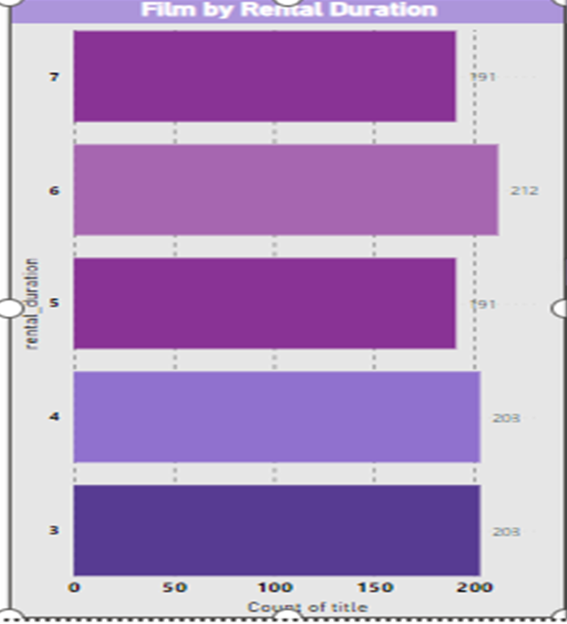
4. What is the distribution of films by rental duration?
In BAR CHART, Rental duration count done the basis of Film Title. Title which have highest Rental duration is 6 = 212

Slide 26
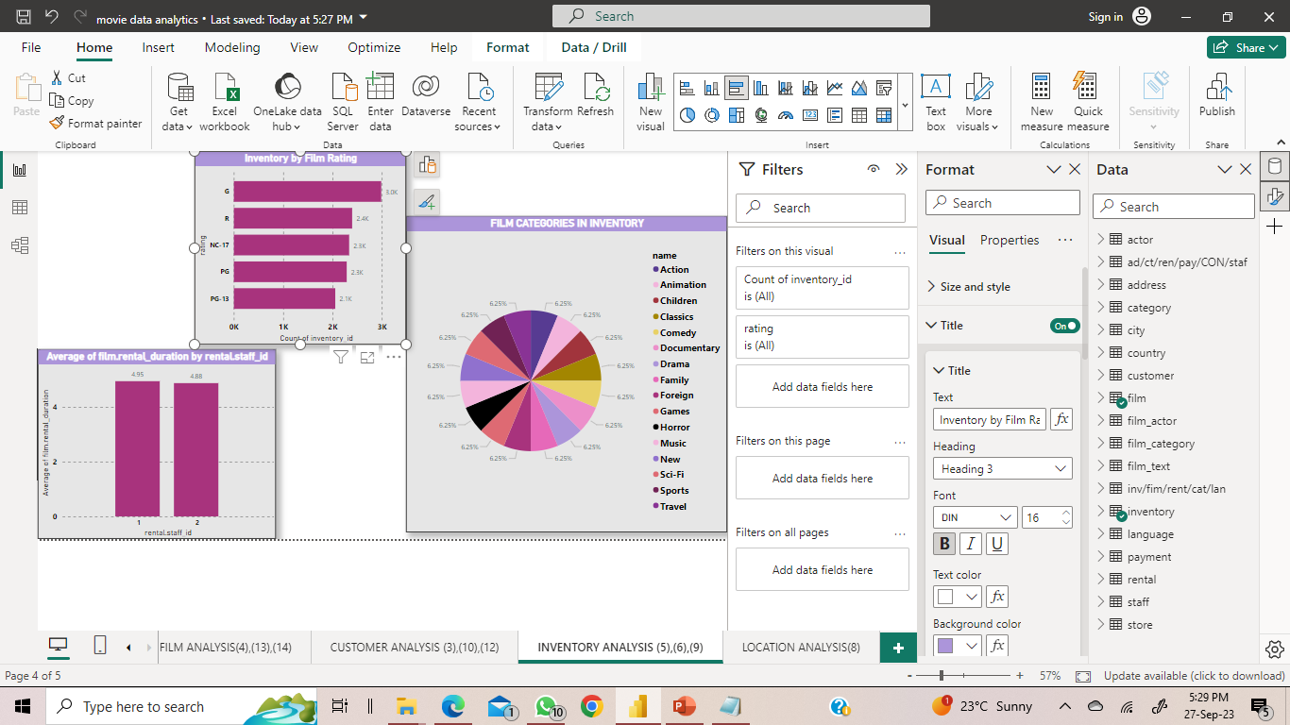
5. How does the inventory vary by film rating?
Bar chart shows inventory vary by film rating. Count of inventory is high in G category = 2985

Slide 27
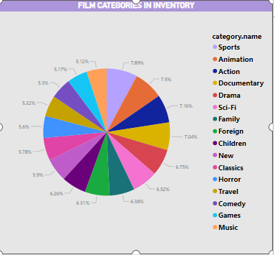
6. What is the breakdown of film categories in the inventory?
Pie chart shows SPORTS category film has more count of inventory_ids = 6948(7.49%)

Slide 28
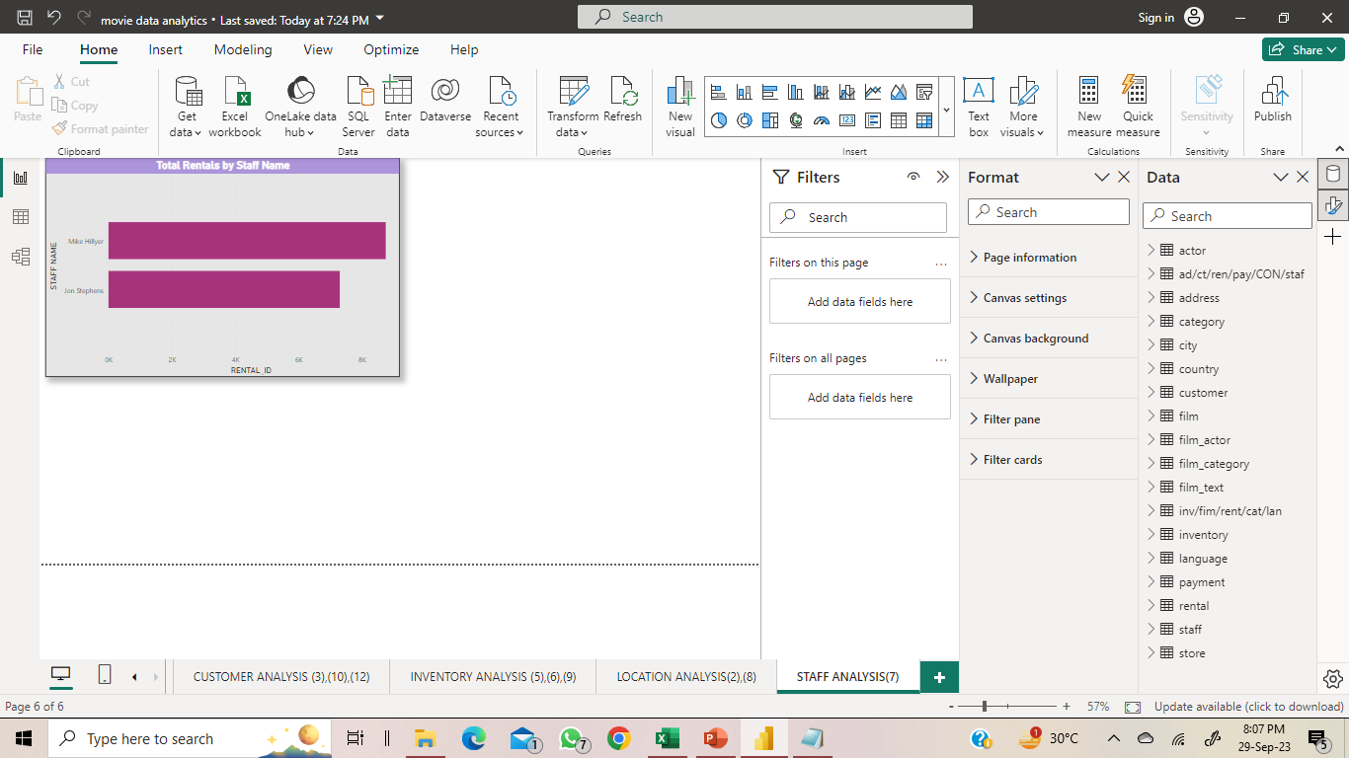
7. What is the distribution of staff by employment duration?
BAR CHART shows mike hillyer have more rental_id = 8747

Slide 29
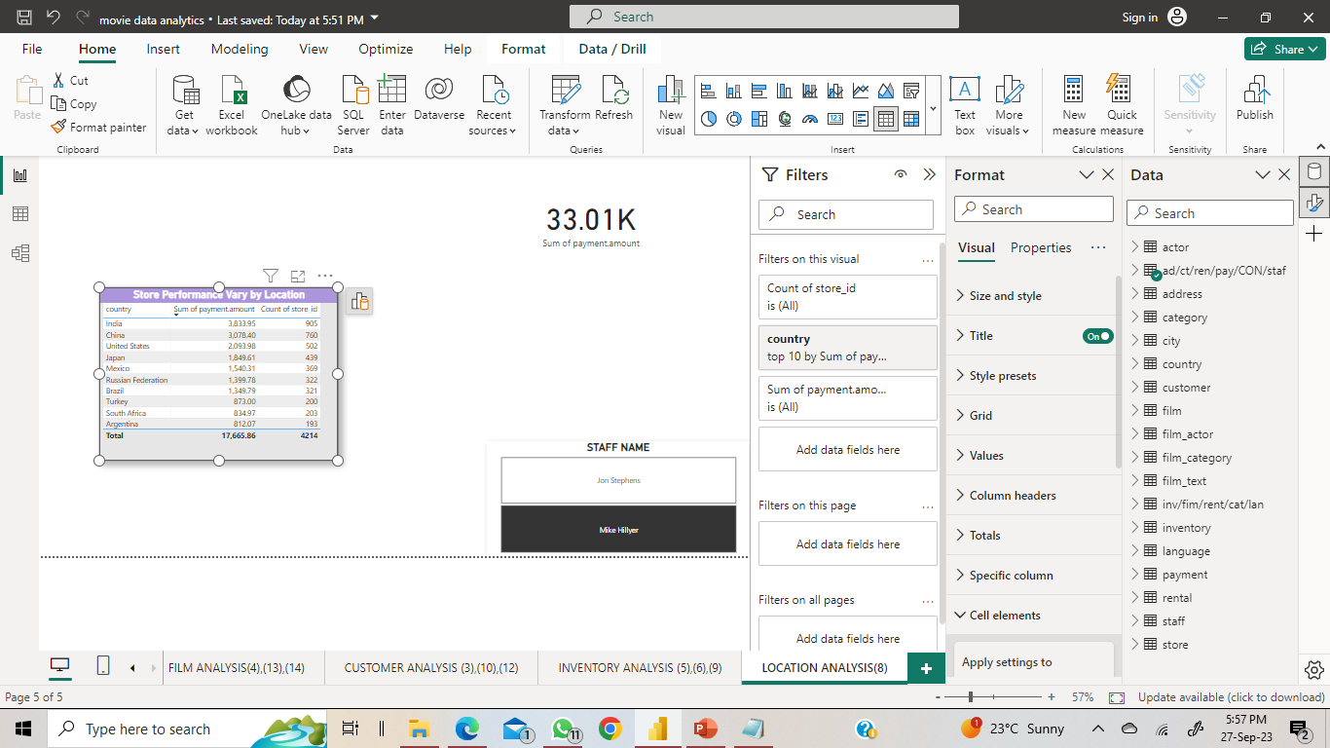
8. How does the store performance vary by location?
TABLE shows store performance vary by location. India have the highest no.of store_id = 905 as well as highest sales = 3833.95 among all countries.

Slide 30
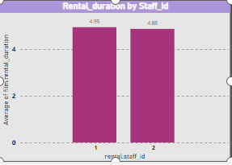
9. What is the average rental duration by staff member?
COLUMN CHART shows rental_duration of each staff. There are only 2 staff_ids. In which Average rental duration of staff_id 1 = 4.95

Slide 31
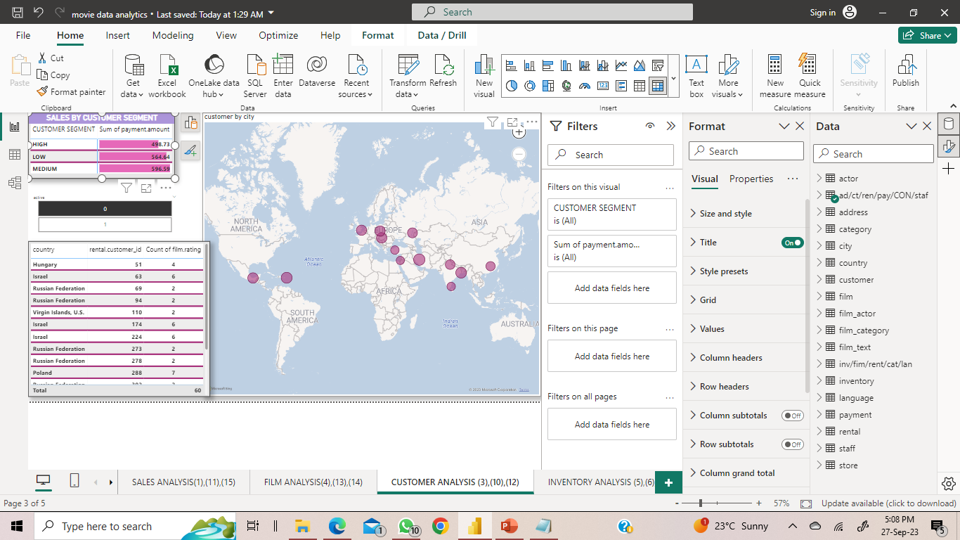
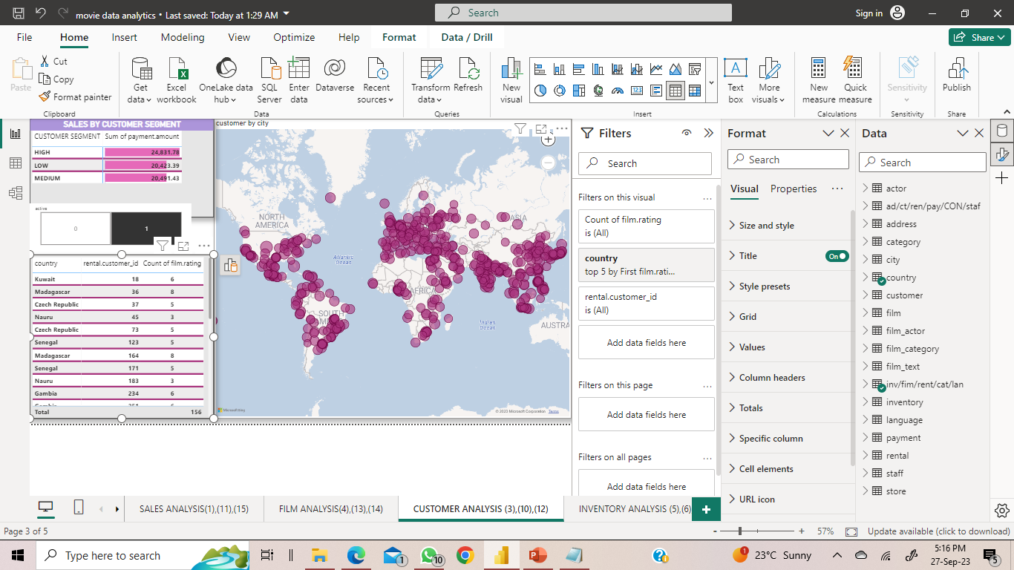
10. What is the distribution of customers across different cities?
Distribution of Customers done the basis of cities.
1st map show INACTIVE customer_id among different cities and 2nd map shows active customer_id among diff. cities.

Slide 32

11. How does the rental revenue vary by country?
BAR CHART shows rental_revenue for countries. INDIA have highest rantal_revenue = 6628.28

Slide 33
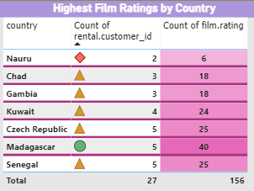
12. Which locations have the highest and lowest customer ratings?
MATRIX shows highest and lowest film_rating on the basis of count distinct customer_id for COUNTRY.
Madagascar have Highest film_rating = 40 and Nauru have Lowest fim_rating = 6

Slide 34
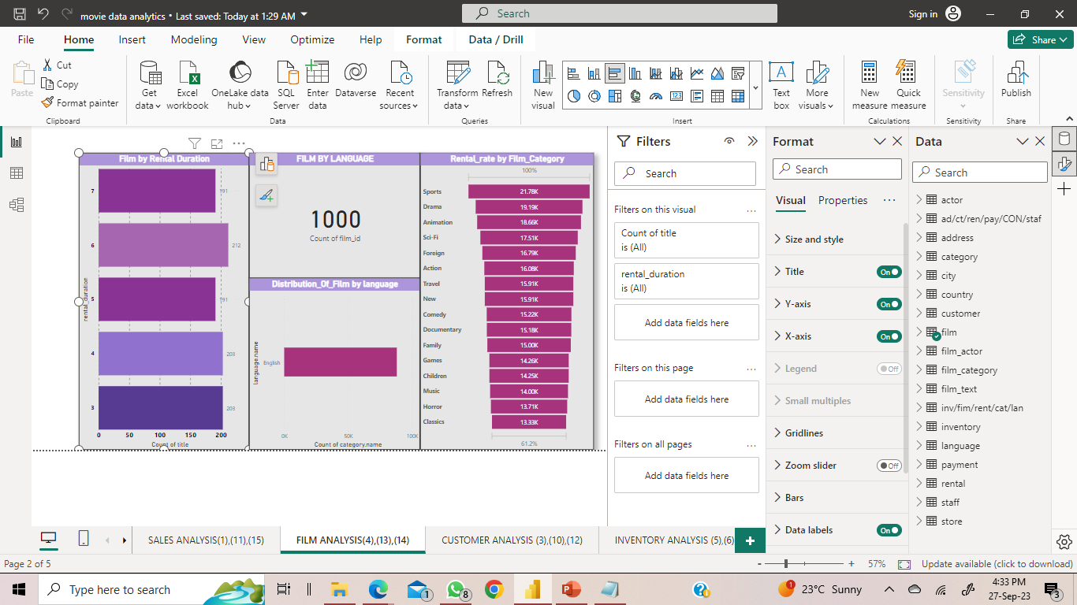
13. What is the distribution of films by language?
In BAR CHART, distribution of films done on the basis of language.
In the analysis we found out all movies are available in English language.

Slide 35
14. Which film categories have the highest rental rates?
FUNNEL CHART shows highest rental_rate on the basis of film_category. It shows SPORTS film_category have highest rental_rates = 21,778.52

Slide 36
15. How does the average rental duration vary by film category?
BAR CHART shows rental_duration done on the basis of film_category. Action film have highest rental_duration = 5679

